Slide 1
SUSTAINABILITY : HOUSEHOLD WATER - USAGE AND BILLING MONITOR
Presented by :
Ojashwitha – 2620030192
Sravani – 2620030488
Yagna Priya - 2620090131

Slide 2
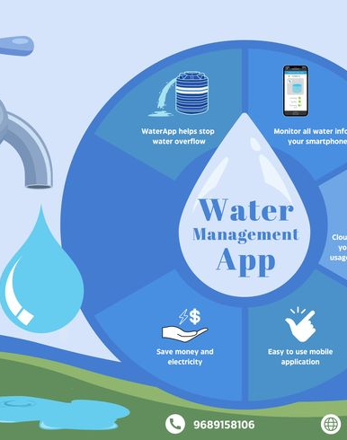
ABSTRACT
The Sustainability Household Usage and Building Monitor is a Java-based application designed to monitor household electricity, water, and waste usage. The system helps users understand their resource consumption and provides suggestions for reducing unnecessary wastage.

Slide 3
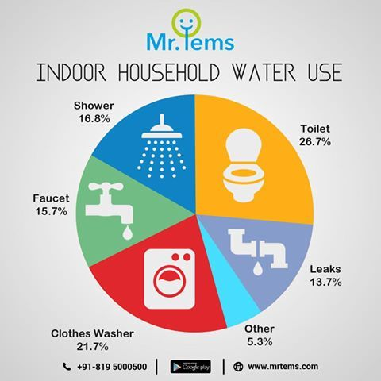
Problem Statement
Households may waste water without realizing it.
Traditional water meters provide limited information.
Users may not know their daily or monthly consumption.
Unexpected high bills can be difficult to understand.
A smart monitoring system can provide timely information and alerts.

Slide 4
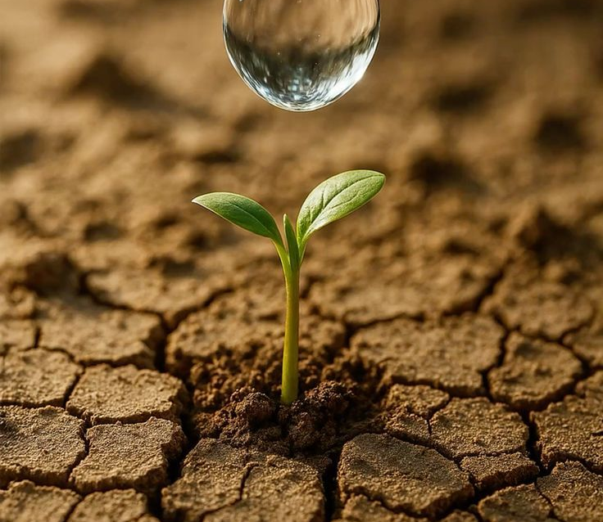
1. Data Types and Variables
Store household water consumption in liters and water bill amounts.
Store customer details and payment status.
2. Operators
Calculate water bills using water consumption and billing rates.
Compare water usage with the limit to identify excessive consumption.
3. Loops and Iterations
Process water usage and calculate bills for multiple households.
Repeat consumption checks to identify excessive water usage and encourage water conservation.

Slide 5
1). Array Traversal​
Traversal = visiting each element in thearray.​
Used to calculate total water usagefor a week/month.​
​
2). Searching​
Identifies wastage patterns ​
Helps identify peak consumption days→ useful for awareness campaigns.​
​
3). Matrix Representation​
Organizes household vs. day usage formonitoring​
Organizes household vs. day usage formonitoring​

Slide 6
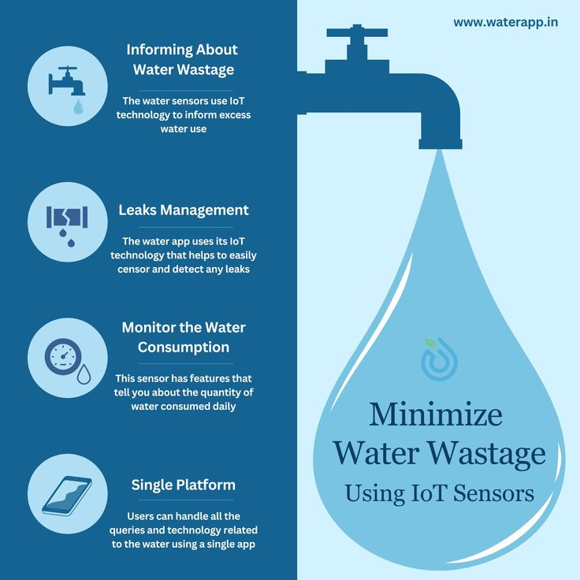
Classes & Objects
Class = Household, Object = specific family’s water data.
Provides structure to store and manage usage/billing info.
Encapsulation
Protects sensitive billing data (usage, charges).
Access only through controlled methods → ensures security

Slide 7
Methods
Functions like calculateBill() or findPeakUsage().
Automates billing and analysis of consumption patterns.
Encapsulation
Protects sensitive billing data (usage, charges).
Access only through controlled methods → ensures security.

Slide 8
*Inheritance
Reuse code: e.g., ResidentialHousehold inherits from Household
Allows specialized billing rules (e.g., apartments vs. villas).
*Polymorphism
Same method, different behavior: calculateBill() works differently for Residential vs. Commercial.
Supports flexible billing models.
*Interfaces
Standardize features: e.g., Billable interface ensures all classes provide generateBill().
Promotes consistency across modules.

Slide 9
File Handling and Data Processing
1).File I/O Streams
Read/write household water usage data from files
Enables storage of daily usage logs and billing records.
2). Collections Framework
Provides dynamic data structures (ArrayList, HashMap).
Useful for managing multiple households and their usage data.
3).Stream API
Process data in pipelines: filter, map, reduce.
Example: calculate total usage across all households in one line.

Slide 10
Generics and Collections in Java
Generics
Enable reusable classes to handle different data types, e.g., WaterUsage<T>.
Improves type safety in household water monitoring.
Bounded Type Parameters
Restrict generic types using T extends Number.
Ensures water usage values are numeric for bill calculations.

Slide 11
Multiple Parameters
Use multiple type parameters, e.g., WaterUsage<Integer, Double>.
Stores house numbers and water consumption values.
Wrapper Classes
Use Integer and Double to represent primitive values as objects.
Helps store water readings in collections.
Autoboxing and Unboxing
Automatically converts primitive values to wrapper objects and back.
Simplifies handling of household water usage data.
Collections Framework
Uses ArrayList<Double> to store multiple water readings.
Helps track consumption and identify high water usage.

Slide 12
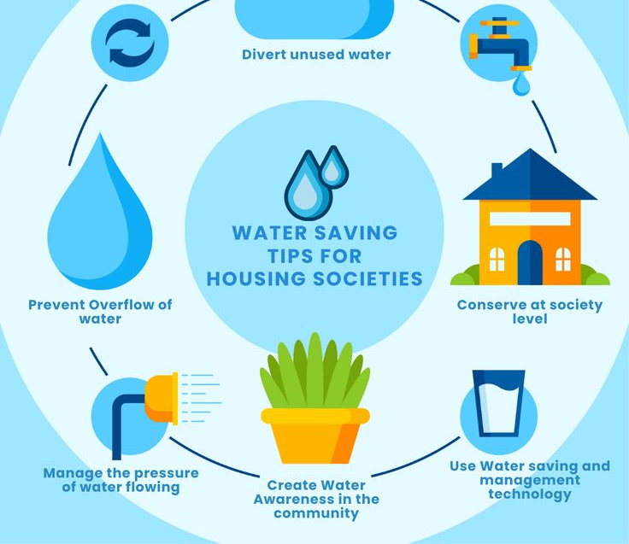
Conclusion
Monitors household water usage and calculates water bills.
Uses Java Generics, Wrapper Classes, and Collections for efficient data management.
Applies bounded type parameters, autoboxing, and unboxing to process water readings.
Identifies excessive water consumption and encourages responsible water usage.
Promotes sustainability through efficient water monitoring and conservation.

